Slide 1
M110: Python Programming Meeting #2 Fundamentals of Python Programming
Prepared by Dr. Ahmad Mikati

Slide 2
Content
Introduction to Python
Running Python Programs
Data Types and Variables
Using Numeric and String Variables
Printing with Parameters
Getting Input from a User

Slide 3
Why Python?
Python is object-oriented
Supports concepts such as polymorphism, operation overloading, and multiple inheritance
It's free (open source)
Downloading and installing Python is free and easy
Source code is easily accessible
Free doesn't mean unsupported! Online Python community is huge
It's portable
Python runs virtually on major platforms used today
As long as you have a compatible Python interpreter installed, Python programs will run in exactly the same manner, irrespective of platform
It's powerful
Dynamic typing
Built-in types and tools
Library utilities
Third party utilities (e.g. Numeric, NumPy, SciPy)
Automatic memory management

Slide 4
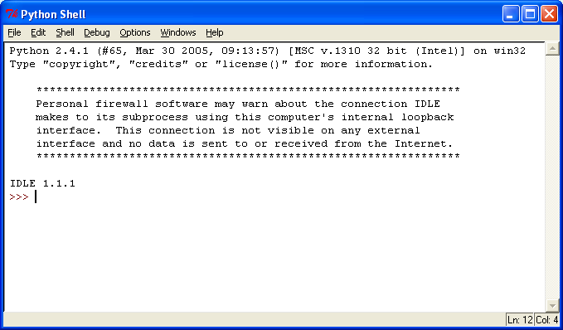
Python IDLE
IDLE: Integrated DeveLopment Environment
After installing the IDLE, you can start writing your Python programs.

Slide 5
Programming Modes in Python
Interactive Mode
gives you immediate feedback
Not designed to create programs to be saved and run later
Script Mode
Write, edit, save, and run (later)
Save your file using the “.py” extension

Slide 6
Create and run programs in Script Mode
Go to the File menu.
Make a new file.
Give a name for the new file such as: firstProgram.py and then save with .py extension.
You can now start writing your code.
To run your code, save it first and then go to the run menu → choose run Module or press F5.

Slide 7

The Program Development Cycle
Programs must be carefully designed before they are written. During the design process, programmers use tools such as pseudocode and flowcharts to create models of programs (as we have seen in lecture one).
The process of creating a program that works correctly typically requires the five phases shown in the below Figure.
The entire process is known as the program development cycle.

Slide 8
The Program Development Cycle
Design the Program: A program should be carefully designed before the code is written.
Write the Code: After designing the program, the programmer begins writing code in a high-level language such as Python, considering the proper syntax.
Correct Syntax Errors: If the program contains a syntax error, the compiler or interpreter will display an error message indicating what the error is.
Test the Program: Once the code is in an executable form, it is then tested to determine whether any logic errors exist.
A logic error is a mistake that does not prevent the program from running but causes it to produce incorrect results.
Correct Logic Errors: If the program produces incorrect results, the programmer debugs the code.

Slide 9
Data Types in Python
Python supports different Data types:
integer (signed integers): positive or negative whole numbers with no decimal point.
float (floating point real values): real numbers and are written with a decimal point dividing the integer and fractional parts. Floats may also be in scientific notation, with E or e indicating the power of 10 (2.5e2 = 2.5 x 10² = 250).
complex (complex numbers): are of the form a + bJ, where a and b are floats and J (or j) represents the square root of -1 (which is an imaginary number). The real part of the number is a, and the imaginary part is b. Complex numbers are not used much in Python programming.

Slide 10
Data Types in Python
Python supports different Data types (cont’d):
Boolean: The Boolean data type is represented in Python as type bool. It has one of the two values True or False. This type is used to compare two values.
>>5==4 False
>>5>=4 True
String: A string in Python can be created using single, double, and triple quotes.
Sequence Types: list, tuple, range (to be discussed later)
N.B: The two consecutive equal marks operator ( == ) returns true if both operands have the same value; otherwise, it returns false .

Slide 11
Python print() Function
A function is a piece of prewritten code that performs an operation. Python has numerous built-in functions that perform various operations. One of the most fundamental built-in functions is the print function.
The print() function prints the specified message to the screen, or other standard output device.
The message can be a string, or any other object, the object will be converted into a string before written to the screen.
print("Hello!", “How are you?")
Hello! How are you?
x = ("apple", "banana", "cherry") print(x)
('apple', 'banana', 'cherry')
These pieces of data are sequences of characters. In programming terms, a sequence of characters that is used as data is called a string. When a string appears in the actual code of a program, it is called a string literal. In Python code, string literals must be enclosed in quote marks (e.g:"apple") .
Literals are numbers or strings that appear directly in a program.

Slide 12
Your First Python Program
Python is "case-sensitive":
print("hello") #correct
print('hello’) #correct
Print("hello") #error
PRINT("hello") #error
"hello" is a String literal.
When the computer does not recognize the statement to be executed, a syntax error is generated.

Slide 13
String Literals
String literals in python are immutable, which means once they are created, they cannot be changed. Strings are surrounded by either single quotation marks, or double quotation marks.
'hello' is the same as "hello".
Strings can be output to screen using the print function. For example: print("hello").
If you want a string literal to contain either a single-quote or an apostrophe as part of the string, you can enclose the string literal in double-quote marks.
Likewise, you can use single-quote marks to enclose a string literal that contains double quotes as part of the string.
print("Don’t panic!")
Don’t panic!
print('Your TMA is about “ ICT Tech" ')
Your TMA is about "ICT Tech"

Slide 14
String Literals
Strings in Python are arrays of bytes representing Unicode characters.
Python does not have a character data type.
A single character is simply a string with a length of 1.
Square brackets can be used to access elements of the string.
Example:
Get the first character of a string (In Python, the 1st character has position 0):
0 | 1 | 2 | 3 | 4 | 5 | 6 | 7 | 8 | 9 | 10 | 11 | 12 | 13 | 14 | 15 | 16 | 17 | 18 | 19
H | e | l | l | o | , |  | A | O | U |  | s | t | u | d | e | n | t | s | !
Index/position
s = "Hello, AOU students!" print(s[1])
e
To get the length of a string, use the len() function, which returns the length of the string.
s = "Hello, AOU students!"
print (len(s))
20

Slide 15
String Literals
To check if a certain phrase or character is present in a string, we can use the keyword in.
s = "Hello, AOU students!"
print('AOU' in s)
True
You can return a range of characters using Slicing.
Slicing format: string[start: stop: step]
It will return a string containing a copy of the characters from start up to, but not including, stop. The step identifies how steps should be taken from start to stop(exclusive).

Slide 16
String Literals
Index/position
0 | 1 | 2 | 3 | 4 | 5 | 6 | 7 | 8 | 9 | 10 | 11 | 12 | 13 | 14 | 15 | 16 | 17 | 18 | 19
H | e | l | l | o | , |  | A | O | U |  | s | t | u | d | e | n | t | s | !
Examples:
Get the characters from position 1 to position 4:
s = "Hello, AOU students!" print(s[1:5])
ello
You can specify the steps:
s = "Hello, AOU students!" print(s[0:5:2])
Hlo
By leaving out the start index, the range will start at the first character.
s = "Hello, AOU students!" print(s[:5])
Hello
By leaving out the stop index, the range will go to the end.
s = "Hello, AOU students!" print(s[7:])
AOU students!

Slide 17

String Literals
You can use negative indexes to start the slice from the end of the string.
b = “Students!" print(b[-6:-1])
dents
Using step value 2
b = “Students!" print(b[-6:-1:2])
dns
Positive indexing
Negative indexing

Slide 18
More about the Print function
You will learn now more details about the Python print function, and you’ll see techniques for formatting output in specific ways.
Overpowering the print Function’s Ending Newline
By default, the value of this parameter is ‘\n’ (the new line character).
Python’s print() function comes with a parameter called ‘end’.
You can end a print statement with any character or string using this parameter.
print('I', end='')
print('Love', end='')
print('Python')
ILovePython
Notice in the argument end='' there is no space between the quote marks.
This specifies that the print function should print nothing at the end of its output.
However, you can include whatever you want between the quotes if you want so.
print('I', end='*')
print('Love', end=' ')
print('Python')
I*Love Python

Slide 19
More about the Print function
Specifying an Item Separator
When multiple arguments are passed to the print function, they are automatically separated by a space when they are displayed on the screen.
print('I', 'Love', 'Python')
I Love Python
If you do not want a space printed between the items (or want anything else to be inserted, you can pass the argument sep='' to the print function, as shown below:
print('I', 'Love', 'Python', sep='')
ILovePython
print('I', 'Love', 'Python', sep=‘*')
I*Love*Python

Slide 20
More about the Print function
Escape Characters
An escape character is a special character that is preceded with a backslash (\), appearing inside a string literal. When a string literal that contains escape characters is printed, the escape characters are treated as special commands that are embedded in the string. For example, \n is the newline escape character.
Several escape characters are recognized by Python, some of which are listed below:
\n: Causes output to be advanced to the next line.
\t: Causes output to skip over to the next horizontal tab position.
\’: Causes a single quote mark to be printed.
\“: Causes a double quote mark to be printed.
\\: Causes a backslash character to be printed.
I
Love
Python
print('I\nLove\nPython')
print('I\tLove\tPython')
I Love Python

Slide 21
More about the Print function
Displaying Multiple Items with the + Operator
When the + operator is used with two strings, however, it performs string concatenation.
print('This is ' + 'one string.')
This is one string.
Formatting Numbers
When a floating-point number is displayed by the print function, it can appear with up to 12 significant digits. When you call the built-in format function, you pass two arguments to the function: a numeric value and a format specifier. The format specifier is a string that contains special characters specifying how the numeric value should be formatted.
print(format(12345.6789, '.2f'))
12345.68

Slide 22
Program Documentation
Comments are short notes placed in different parts of a program, explaining how those parts of the program work.
Comment lines provide documentation about your program.
Anything after the “#” symbol is a comment
Ignored by the computer
# First Python Program
# January 30, 2025
# print(“Hello!”)

Slide 23
Variables
A variable is a name that represents a value stored in the computer’s memory.
Variables let us store and reuse values in several places.
Programs use variables to access and manipulate data that is stored in memory.
To do this we need to define the variable and then tell it to refer to a value.
We do this using an assignment statement. variable = expression
Example:
y = 3
print(y)
3

Slide 24
Variables
You can also assign to multiple names at the same time.
Example1:
>>> x,y = 2,3
>>> x
2
>>> y
3
Example2:
>>> x = 5; y = 4;

Slide 25
Variables- Rules
Variable names can contain letters, numbers, and the underscore (the dollar sign is NOT accepted!).
Variable names cannot contain spaces.
Variable names cannot start with a number.
Variable name cannot be a reserved word.
Case matters: temp and Temp are different variables.
There are many reserved words such as:
and, not, or, assert, break, class, continue, def, del, elif, else, except, exec, finally, for, from, global, if, import, in, is, lambda, pass, print, raise, return, try, while
WARNING! You cannot use a variable until you have assigned a value to it. An error will occur if you try to perform an operation on a variable, such as printing it, before it has been assigned a value.

Slide 26
Displaying Multiple Items with the print Function
Python allows us to display multiple items with one call to the print function.
We simply need to separate the items with commas as shown in the following program:
# Displaying multiple items with one call
Course_Name="Python Programming"
Course_Section=210
print("The course is",Course_Name,“, and my section is",Course_Section )
Output:
The course is Python Programming , and my section is 210

Slide 27
Reading from the keyboard
To read from the keyboard, you normally use the input function in an assignment statement that follows this general format:
variable = input(prompt)
x=input(“enter your text: ” )#Hello Ahmad
print(x)
Enter your text: Hello Ahmad
Hello Ahmad
For reading values (numbers) from the keyboard we can use “eval()” which converts the string to values.
x =eval(input("enter a number: "))
y =eval(input("enter another number: "))
print("The sum of both numbers is:",x+y)
enter a number: 5
enter another number: 10
The sum of both numbers is: 15

Slide 28
Math Operators
Name | Meaning | Example | Result
+ | Addition | 34 + 1 | 35
- | Subtraction | 34.0 - 0.1 | 33.9
* | Multiplication | 300 * 30 | 9000
/ | Float Division | 1 / 2 | 0.5
// | Integer Division | 1 // 2 | 0
** | Exponentiation | 4 ** 0.5 | 2.0
% | Remainder | 20 % 3 | 2
Can be used also for string concatenation: y="hello"
print(y+" world!")
==> hello world!
Can be used also for string repetition:
print("Hi " * 3)
==> Hi Hi Hi

Slide 29
Operator Precedence
You can write statements that use complex mathematical expressions involving several operators.
First, operations that are enclosed in parentheses are performed first. Then, when two operators share an operand, the operator with the higher precedence is applied first.
Parts of a mathematical expression may be grouped with parentheses to force some operations to be performed before others.
The precedence of the math operators, from highest to lowest, are:
Parentheses ()
Exponentiation: **
Multiplication, division, and remainder: * / // %
Addition and subtraction: + −
5 + 2 * 4 //13
10 / 2 − 3 //2.0
8 + 12 * 2 − 4 //28
6 − 3 * 2 + 7 − 1 //6
(6 − 3) * (2 + 7) / 3 //9.0

Slide 30
Casting in Python
Python converts numbers internally in an expression containing mixed types to a common type for evaluation.
Sometimes, you need to explicitly convert a number from one type to another. This is called casting.
int(x) to convert x to a plain integer.
float(x) to convert x to a floating-point number.
str() to construct string from a wide variety of data types, including strings, integer literals and float literals
complex(x) to convert x to a complex number with real part x and imaginary part zero.
complex(x,y) to convert x and y to a complex number with real part x and imaginary part y. x and y are numeric expressions.

Slide 31
Casting in Python
>>> x = '100'
>>> y = '-90'
>>> print (x + y)
100-90
>>> print (int(x) + int(y))
10
Since they are strings, x and y will be concatenated
Since they have been casted, values of x and y will be added

Slide 32
Casting in Python
Casting to integers:
x=int(input(“enter the value”)) #5
y=int(input(“enter the value”)) #10
x+y = 15
Casting to floats:
x=float(input(“enter the value”)) #5.0
y=float(input(“enter the value”)) #10.0
x+y= 15.0
Casting to strings:
x = str("s1") # x will be 's1' y = str(2) # y will be '2' z = str(3.0) # z will be '3.0'

Slide 33
More about Strings
String Testing Methods
Method | Description
isalnum() | Returns true if the string contains only alphabetic letters or digits and is at least one character in length. Returns false otherwise.
isalpha() | Returns true if the string contains only alphabetic letters and is at least one character in length. Returns false otherwise.
isdigit() | Returns true if the string contains only numeric digits and is at least one character in length. Returns false otherwise.
islower() | Returns true if all of the alphabetic letters in the string are lowercase, and the string contains at least one alphabetic letter. Returns false otherwise.
isspace() | Returns true if the string contains only whitespace characters and is at least one character in length. Returns false otherwise. (Whitespace characters are spaces, newlines (\n), and tabs (\t).
isupper() | Returns true if all the alphabetic letters in the string are uppercase, and the string contains at least one alphabetic letter. Returns false otherwise.

Slide 34
More about Strings
Modification Methods
Although strings are immutable, meaning they cannot be modified, they do have several methods that return modified versions of themselves.
Method | Description
lower() | Returns a copy of the string with all alphabetic letters converted to lowercase. Any character that is already lowercase, or is not an alphabetic letter, is unchanged.
lstrip() | Returns a copy of the string with all leading whitespace characters removed. Leading whitespace characters are spaces, newlines (\n), and tabs (\t) that appear at the beginning of the string.
lstrip(char) | The char argument is a string containing a character. Returns a copy of the string with all instances of char that appear at the beginning of the string removed.
rstrip() | Returns a copy of the string with all trailing whitespace characters removed. Trailing whitespace characters are spaces, newlines (\n), and tabs (\t) that appear at the end of the string.
rstrip(char) | The char argument is a string containing a character. The method returns a copy of the string with all instances of char that appear at the end of the string removed.
strip() | Returns a copy of the string with all leading and trailing whitespace characters removed.
strip(char) | Returns a copy of the string with all instances of char that appear at the beginning and the end of the string removed.
upper() | Returns a copy of the string with all alphabetic letters converted to uppercase. Any character that is already uppercase, or is not an alphabetic letter, is unchanged.

Slide 35
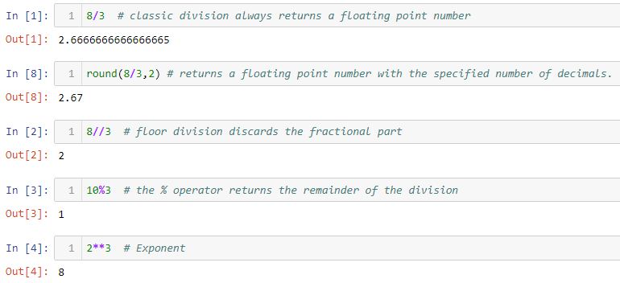
Drill Examples

Slide 36
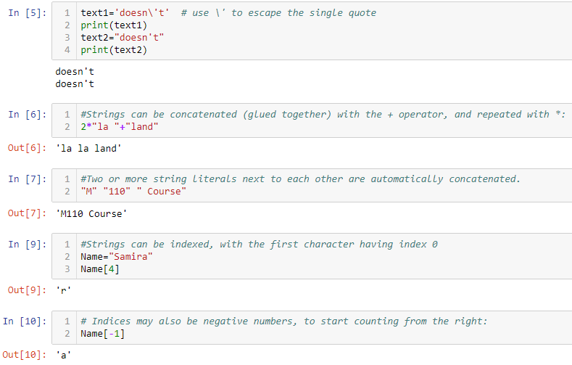
Drill Examples

Slide 37
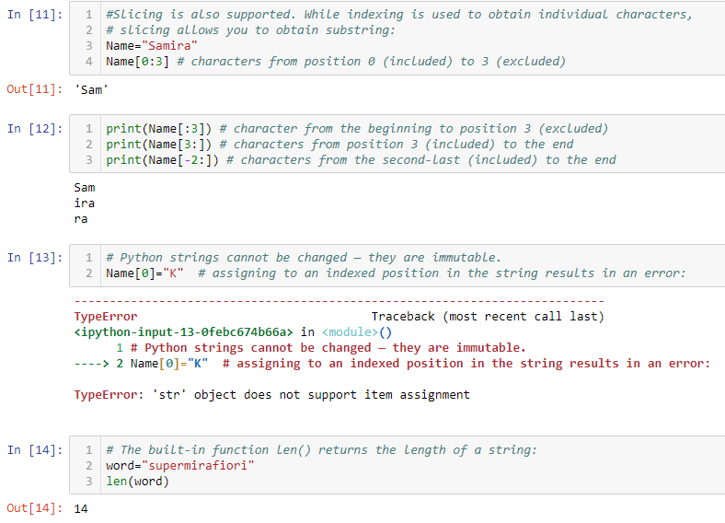
Drill Examples

